Slide 1


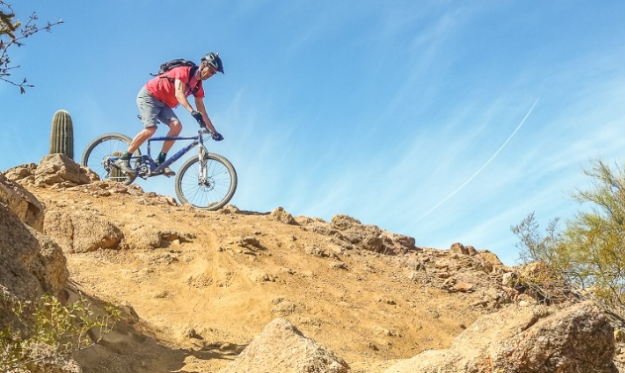
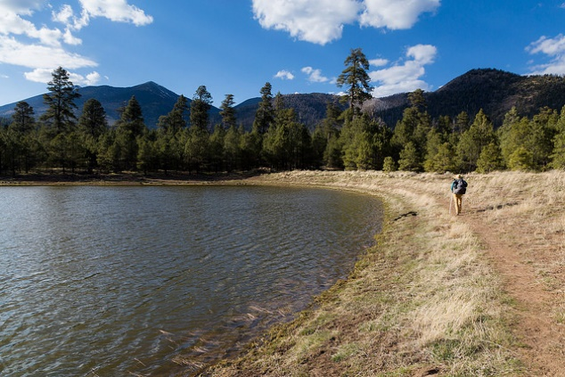
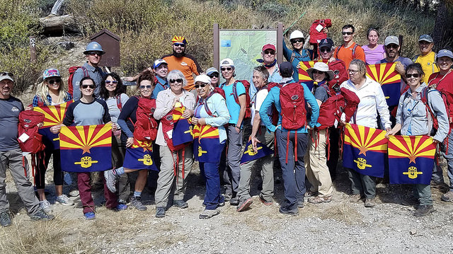
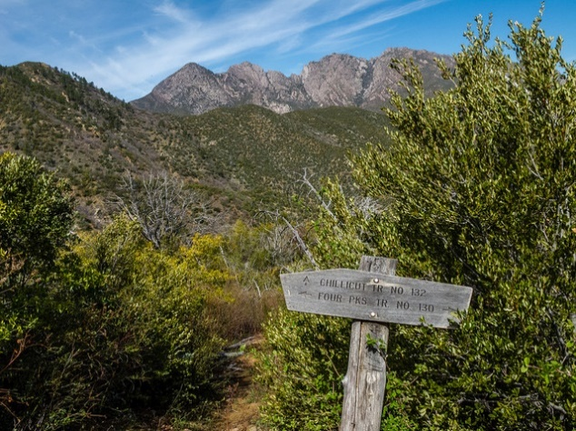
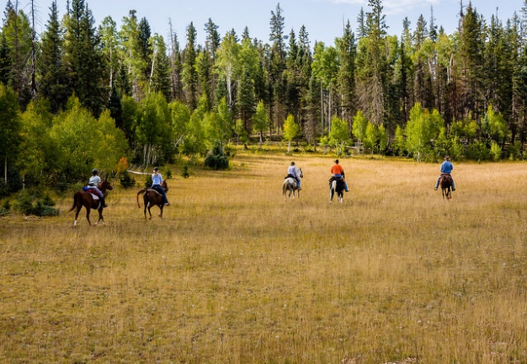
NEPA and Trails in the US Forest Service
Caring for the Land and Serving People.

Slide 2

???
Why is it so seemingly difficult to build something so simple as a trail?
Caring for the Land and Serving People.
Notes:
The purpose of this presentation is to talk to you about the requirements that must be met for building, maintaining, relocating existing National Forest System Trails or incorporating social trails, ad hoc trails, into the National Forest Trail System.

Slide 3
Pop Quiz
Where does the following statement come from?
To declare national policy which will encourage productive and enjoyable harmony between man and his environment; to promote efforts which will prevent or eliminate damage to the environment and biosphere and stimulate the health and welfare of man; to enrich the understanding of the ecological systems and natural resources important to the Nation; and to establish a Council on Environmental Quality.
Caring for the Land and Serving People.

Slide 4
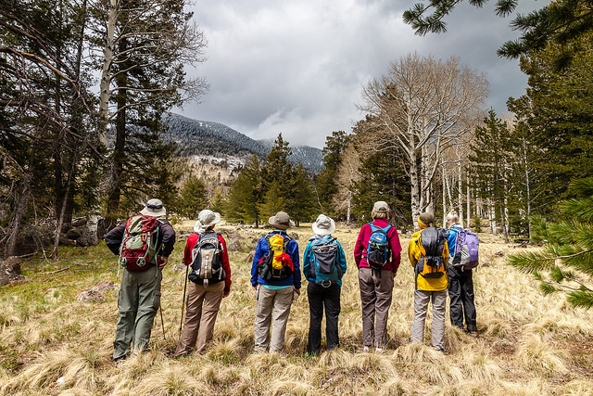
Pop Quiz
Answer
It’s the preamble to the National Environmental Policy Act.
An Act to establish a national policy for the environment
Caring for the Land and Serving People.

Slide 5

What is NEPA?
National Environmental Policy Act
Basic national charter for protecting our environment;
Fosters action that protects, restores, and enhances our environment;
Requires Public Officials to take a “hard look” at the potential environmental consequences of every proposed project.
Caring for the Land and Serving People.

Slide 6
Purpose of NEPA
Consider potential environmental consequences before taking action
Involve and inform the public in the consideration of potential environmental consequences
Make informed decisions to take action with the best information available
Notes:
The ultimate decision made pursuant to the NEPA process is not to always select the least environmentally effected alternative, but to make an informed decision.

Slide 7
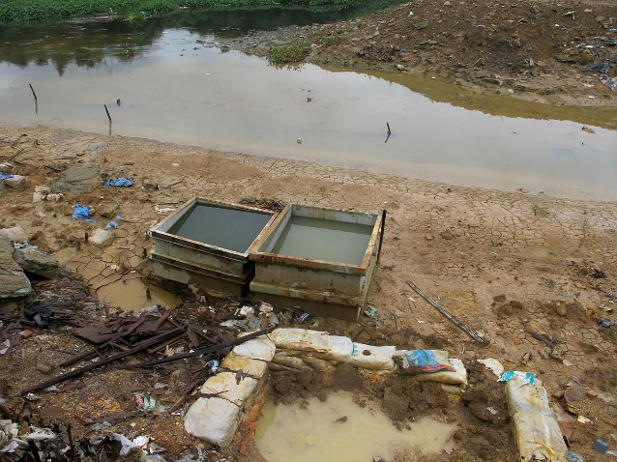
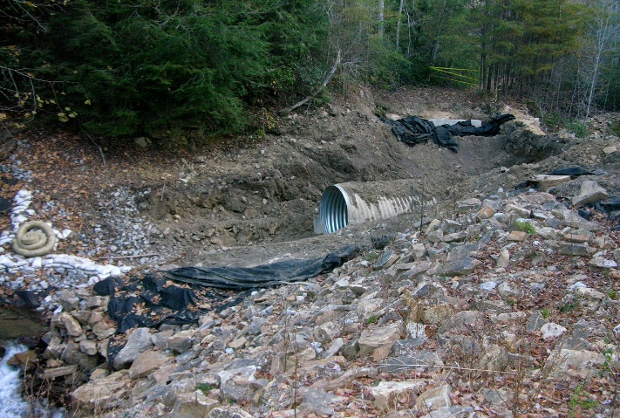
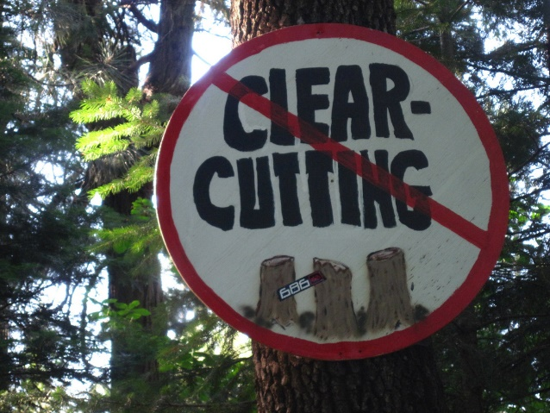
History
Signed into law on January 1, 1970
Decades of environmental neglect
Degrading national landscape
Damaged human environment
Caring for the Land and Serving People.

Slide 8
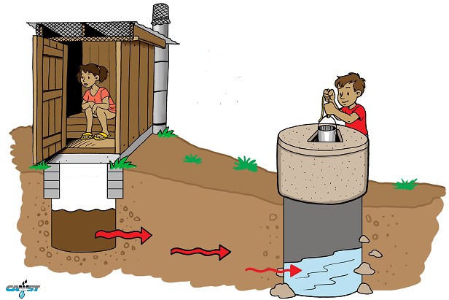

Why NEPA?
Because the American Public wanted Environmental Protection and transparency in the Public Decision Making Process
1930s ~ Rapid Industrialization
ACOE ~ Damming of rivers
Interstate Highway Program
Pesticides and Fertilizers
Logging and clear cutting
Caring for the Land and Serving People.

Slide 9

Back to the ???
Why is it so seemingly difficult to build something so simple as a trail?
Because all federal actions require an environmental analysis stating the potential environmental effects of that action when the agency is exercising discretion to decide how to implement that action.
Caring for the Land and Serving People.

Slide 10
What is a Federal Action?
Actions with effects that may be major and which are potentially subject to Federal control and responsibility.
New and continuing activities
Projects and programs funded, regulated or approved by Federal Agencies
Notes:
May- we don’t’ know until they’ve been analyzed by specialists

Slide 11
What is a Federal Action?
Federal actions tend to fall in 1 of 4 categories
Adoption of Official Policy
Adoption of Formal Plans
Adoption of programs
Approval of specific projects such as construction or management activities located in a defined geographic area

Slide 12
Recap of Federal Action
If…
It is an existing or new project, or
Involves federal dollars, or
Is approved by a federal agency, or
Is discretionary, or
May result in major effects to the environment
NEPA Applies

Slide 13
What about Trails?
Constructing, maintaining, rerouting or adopting an ad-hoc trail on NFS lands is a federal action, and therefore requires some level of environmental analysis under NEPA.

Slide 14
3 Levels of NEPA Analysis
Categorical Exclusion
Environmental Analysis
Environmental Impact Statement

Slide 15
Categorical Exclusions (CE)
Proposed actions may be categorically excluded from analysis and documentation in an EIS or EA, if:
  There are no extraordinary circumstances related to the proposed action, and
  If the proposed action is within one of the categories in 36 CFR 220 or is a listed category in section 31.12 or 31.2 of the Environmental Policy and Procedures Handbook, chapter 30 (FSH 1909.15).
Notes:
36 CFR PART 220—NATIONAL ENVIRONMENTAL POLICY ACT (NEPA) COMPLIANCE
A CE may not be used if there are extraordinary circumstances that indicate potential for significant effects to the natural and human environment.

Slide 16
Extraordinary Circumstances
FSH 1909.15 at 31.2 provides the following list of resource conditions that should be considered:
  Federally listed threatened or endangered species or designated critical habitat;
  Flood plains, wetlands, or municipal watersheds;
  Congressionally designated areas, such as wilderness, wilderness study areas, or national recreation areas;
  Inventoried roadless areas;
  Research natural areas;
  American Indians and Alaska Native religious or cultural sites;
  Archaeological sites, or historic properties or area’s.
There may be other resource conditions specific to an area, so the above list is not the sole source, but generally account for most situations.

Slide 17
CEs for Trails
36 CFR 220.6(d)(4)
  (iv) Pruning vegetation and cleaning culverts along a trail and grooming the surface of the trail; and
36 CFR 220.6(e)(1)
Construction and reconstruction of trails. Examples include but are not limited to:
  (i) Constructing or reconstructing a trail to a scenic overlook and
  (ii) Reconstructing an existing trail to allow use by handicapped individuals.

Slide 18
Mere Presence
IMPORTANT - “The mere presence of one or more of the cited resource conditions does not preclude use of a categorical exclusion. It is the degree of the potential effect of a proposed action on these resource conditions that determines whether extraordinary circumstances exist.”
Refer to 36 CFR 220.6(b); FSH 1901.15, 31.2; and Federal Register Notice of July 6, 2004.
Notes:
Prior to this clarification, the agency was being challenged on its use of CE’s if one of the resource conditions was simply present and pressed the need for either an EA or EIS. This prompted the need for revision. As part of the notice and comment process, many entities voiced concern, especially as they did not want to see expanded use of CE’s. The agency responded to these comments in the Federal Register. Emphasis was placed that if there was uncertainty about effects on a resource condition, then use of a CE would not be appropriate. Moreover, it was stressed that the revision does not change the assumptions upon which the categories of actions listed in that they are appropriate to use because experience has demonstrated they have no individually or cumulatively significant environmental impact.
Moreover, scoping of the proposed action is required for all actions, regardless if they are able to be categorically excluded. If there is uncertainty regarding effects, then use of a CE would not be appropriate.

Slide 19
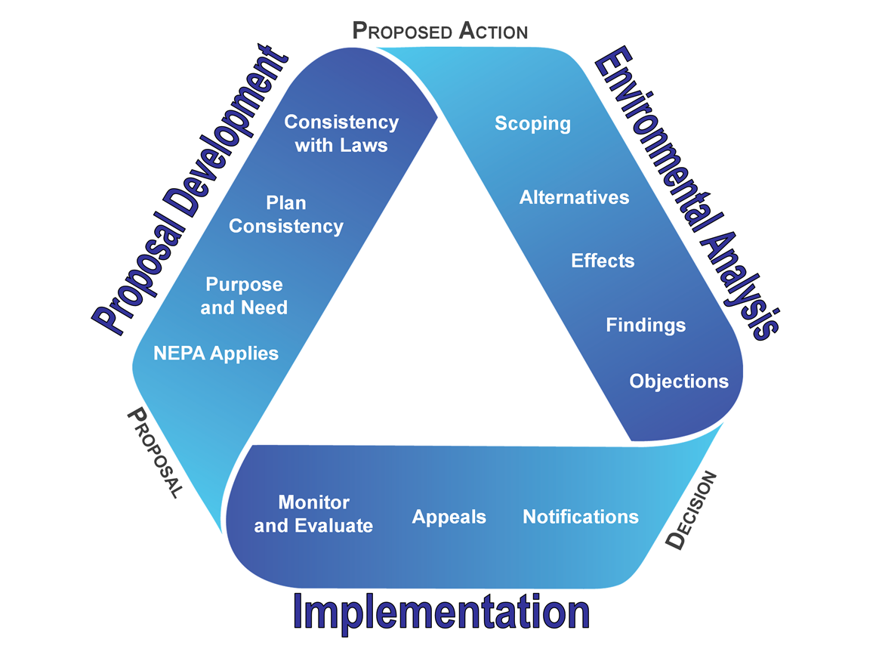
Steps to NEPA Process
Notes:
Continuing slides will focus on purpose/need and proposed action for special uses. No further discussion on the various steps in the NEPA process will be pursued.
NEPA Triangle – Mobius ribbon for triangle; steps moved to inside triangle tape; all fonts changed to Arial

Slide 21
Thank You
Greg Schuster
Tonto National Forest
Recreation Program Manager
gjschuster@fs.fed.us
Questions?

Slide 22
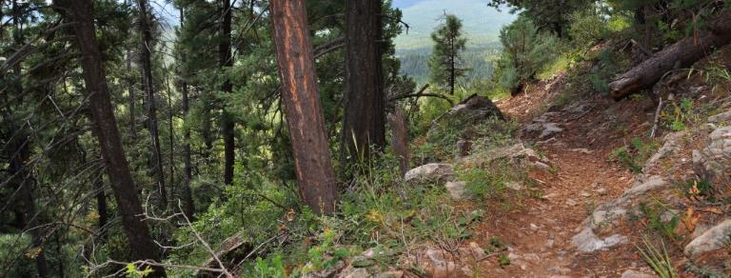
Trails Connect!…
A Convergence of Focus and Opportunity
Notes:
(Speaker Notes)

Slide 23
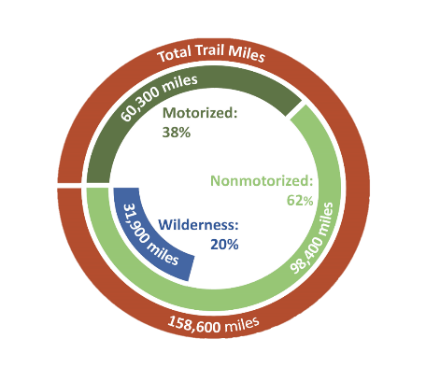
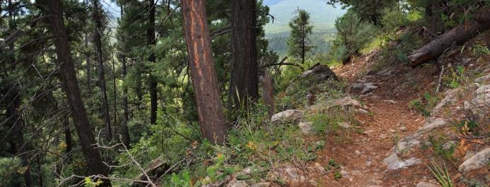
National Forest System Trails
World Class System of Trails
Notes:
Speaker Notes:
National Forest System Trails: World Class System of Trails
To provide some context…
Total: 158,000 miles (largest managed system of trails in the US)
Includes:
Motorized & non-motorized
Standard/Terra, Snow & Water Trails
Wilderness: 32,000 miles (20%)
National Scenic, Historic & Recreation Trails: 10,000+ miles
84 million people: annually recreate on National Forest System trails
Economic Contribution of Recreation on National Forests & Grasslands:
143,000 jobs annually supported by recreation & tourism spending
> $9 billion in annual visitor spending

Slide 24
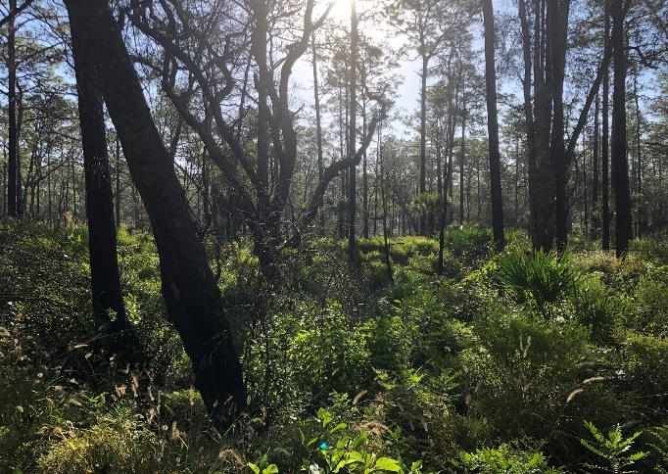
Trails Connect!
Trails connect—they connect people with each other, with themselves, with their community, with their heritage, with their future, and with their public lands.
Notes:
Speaker Notes:
Trails Connect!
From backyards and urban areas…
…to remote and wild places…
“Trails Connect— people with each other, with themselves, with their community, with their heritage, with their future, and with their public lands.”

Slide 25
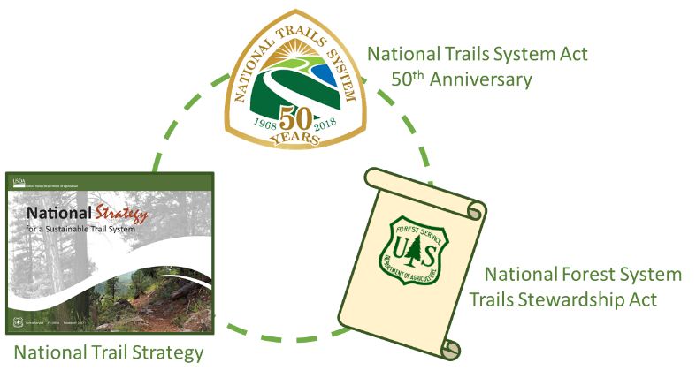
Trails Connect!
Notes:
Speaker Notes:
2018… Trails Connect! …a convergence of opportunity
National Trail Strategy
Trails Stewardship Act
50th Anniversary of the National Trails System Act in 2018

Slide 26
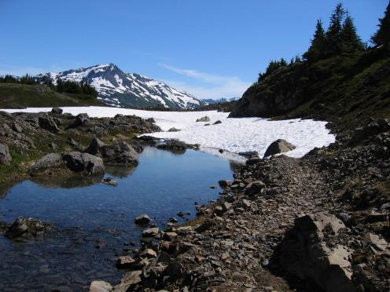
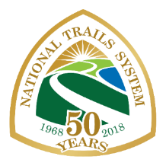
National Trails System Act
50th Anniversary
Discover. Connect. Explore.
#FindYourTrail
www.trails50.org
Notes:
Speaker Notes:
1st Trails Connect! Component:
50th Anniversary of the National Trails System Act in 2018:
Passed on Oct. 2, 1968 (same date the Wild & Scenic Rivers Act was passed)
Launched national system of congressionally designated trails (i.e. Pacific Crest, Appalachian, Continental Divide Trails)
2018 Focus:
Multi-partner / Interagency
Grassroots momentum
Associated events throughout 2018

Slide 27
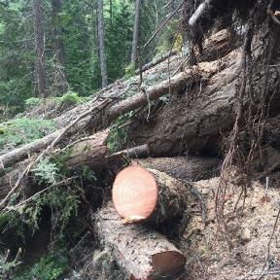
A Need for Change
2013 GAO Trail Maintenance Report:
“The Forest Service has more miles of trail than it has been able to maintain…”
Miles meeting standard: 25%
Miles annually receiving maintenance: 37%
Costs:
Deferred Maintenance: $314 million
Additional Costs: $210 million
(annual maintenance, capital improvement & operations)
Annual Budget: ~ $77 - $80 million
Notes:
Speaker Notes:
A Need for Change
2013 GAO Trail Maintenance Report:
“The Forest Service has more miles of trail than it has been able to maintain…”
Miles meeting standard: 25%
All miles: 37,000
Wilderness miles: ~ 8,000
Miles annually receiving maintenance: 37%
Costs:
Deferred Maintenance: $314 million
Additional Costs: $210 million
(annual maintenance, capital improvement & operations)
Annual Budget: ~ $77 - $80 million

Slide 28
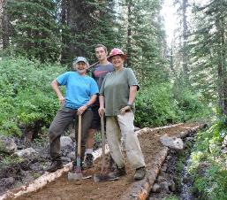
National Forest System
Trails Stewardship Act
Aim to double trail maintenance by volunteers and partners
Explore and study approaches
to increase trail maintenance:
  Trail Maintenance Priority Areas
  Outfitter/Guide Pilot Program
  Fire Crews
Develop and publish Volunteer/Partner
Trail Maintenance Strategy
Report on findings and recommendations
Notes:
Speaker Notes:
3rd Trails Connect! Component:
National Forest System Trails Stewardship Act
Aim to double trail maintenance by volunteers and partners
Explore and study approaches to increase trail maintenance:
Trail Maintenance Priority Areas
Outfitter/Guide Pilot Program
Fire Crews
Develop and publish Volunteer/Partner Trail Maintenance Strategy
Report on findings and recommendations

Slide 29
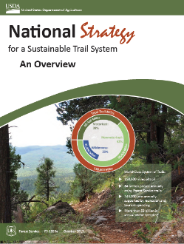
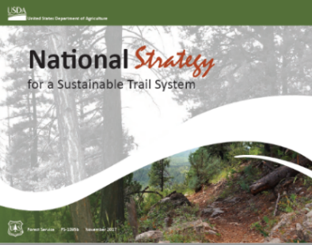
USDA Forest Service
National Trail Strategy
www.fs.fed.us/trails
Notes:
Speaker Notes:
2nd Trails Connect! Component:
National Strategy for a Sustainable Trail System
Developed 2014 – 2016: With input and assistance from hundreds of employees (at all levels of the agency), partners and volunteers
Completed: 2017
Trail Strategy & Overview:
Published: by USDA and released by Chief Tooke Feb. 2018 → distributed internally and externally
A Call to Action!

Slide 30
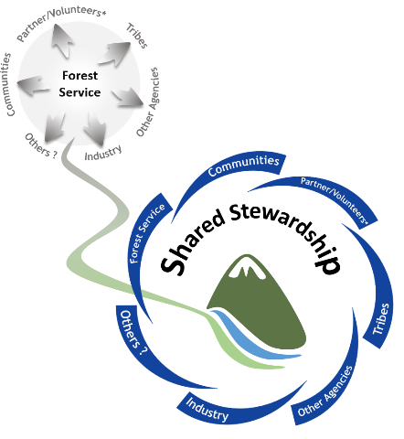
National Trail Strategy
A Need for Change
Shifting to a Model of Shared Stewardship
Notes:
Speaker Notes:
A Need for Change
158,000 miles is a lot of trail…
“It’s a huge resource, a huge opportunity, and a huge challenge, that we cannot meet alone.”
Chief Tom Tidwell
Shifting to a Model of Shared Stewardship:
Shifting from a model of the Forest Service attempting to “do it all”
(to meet the expectations and needs of trail users and stakeholders)…
To a model where the Forest Service, trail users, and stakeholders form a collective community of stewards who provide support to and receive shared benefits from trails.

Slide 31
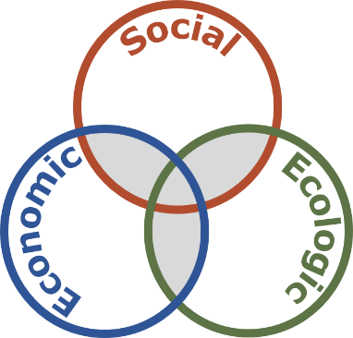
Frontliners!
Where the Rubber Meets the Road
Sustainability is achieved at the junction where trails are:
Socially relevant & supported;
Ecologically resilient; and
Economically viable
Notes:
Speaker Notes:
The concept of sustainability is interwoven throughout the national trail strategy…
3 Spheres of Sustainability
Social, ecologic, and economic considerations…
Essential elements of a sustainable trail system.
Sustainability is achieved at the junction where trails are socially relevant and supported, ecologically resilient, and economically viable.

Slide 32
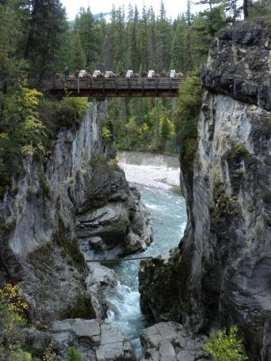
National Trail Strategy
Areas of Action
Leader Intent
Organization & Talent
Relevancy
Sustainable Systems
Agency Processes & Culture
Information
Notes:
Speaker Notes:
The National Trail Strategy:
Establishes a bold vision for achieving a collaboratively stewarded and sustainable system of trails; and
Areas of Action:
The Trail Strategy identifies 6 areas that require action in order to shift toward and achieve a collaboratively stewarded and sustainable trail system:
Leader Intent
Organization and Talent
Relevancy
Sustainable Systems
Agency Processes and Culture
Information
Each area poses a challenge that can be transformed into an aspiration… that’s achieved through a series of focused actions.
Key to that transformation is the capacity of people, resources, and ideas.
By shifting to a model of shared stewardship, with combined energy and resources, we will expand capacity and create the space to achieve these aspirations.
Actions can be scaled and adapted
We‘re incorporating several of these actions into a 10-Year Sustainable Trails Stewardship Challenge and into our annual program of work over the next decade.

Slide 33

National Trail Strategy
Implement 10-Year Challenge (Action 1.2)
Using the 50th anniversary of the National Trails System Act in 2018 as a catalyst, invite partners, volunteers, and employees to develop and implement a bold, national 10-Year Sustainable Trails Stewardship Challenge toward achieving a sustainable system of trails.
Notes:
Speaker Notes:
National Trail Strategy:
Action 1.2 – Implement 10-Year Challenge (10YTC)
Using the 50th anniversary of the National Trails System Act in 2018 as a catalyst,
invite partners, volunteers, and employees to develop and implement
a bold, national 10-Year Sustainable Trails Stewardship Challenge
toward achieving a sustainable system of trails.
10YTC Main Goals:
Increase local agency & partner capacity
Increase on-the-ground-results
Development → Implementation: The 10YTC is currently undergoing development—with the input of employees, partners and other stakeholders—with the intent of agency-wide and partner implementation later in 2019.
The intent is for the 10YTC to be adaptive at all levels of the agency—to reflect and address the collectively identified needs, issues, and opportunities of FS units, communities, partners/volunteers, and other stakeholders.

Slide 34
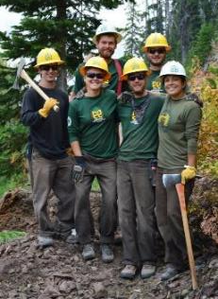

Trails Connect!
Notes:
Speaker Notes:
Trails Connect!
So its in the context and spirit of Trails Connect! and these 3 components that we’re inviting agency employees and partners to join together in developing and implementing a 10-Year Trail Challenge over the next decade…
…to help us collectively shift toward a collaboratively stewarded, highly valued, and sustainable system of trails.

