Slide 1
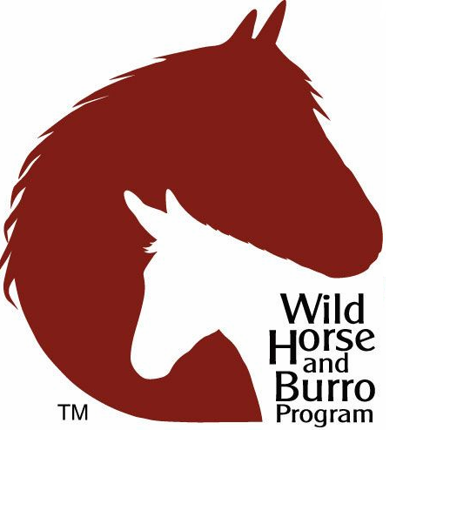
The Wild Horse and Burro Program
John Hall
Bureau of Land Management
Wild Horse and Burro State Lead
Florence Prison Training and Holding Facility Manger
Phoenix/Florence Arizona

Slide 2
The Wild Free-Roaming Horse and Burro Act of 1971
“It is the policy of Congress that wild free-roaming horses and burros shall be protected from capture, branding, harassment, or death; and to accomplish this they are to be considered in the area where presently found, as an integral part of the natural system of the public lands.”

Slide 3
The Wild Free-Roaming Horse and Burro Act of 1971
Before the WFRHB Act, WHB were not protected from Mustangers and Ranchers
WHB in AZ were managed under the AZ Livestock Sanitation Board
Could be taken as a meat species due to the lack of natural predators
The Wild Horse Annie Act passed in 1959 prohibited hunting of WHB from any motorized vehicle
Velma B. Johnson “Wild Horse Annie”
Public interest created by this act would later lead to the passing of the WFRHB Act

Slide 4
The Wild Free-Roaming Horse and Burro Act of 1971
Public Law 92-195, which protects WHB within designated territories on both Forest Service and BLM lands
These territories are called Herd Management Areas (HMA) or Herd Areas. Forest Service territories
Mandates WHB are managed in a thriving ecological balance with the land and as part of the natural landscape

Slide 5
WHB in Arizona
Wild Horses likely introduced by Spanish explorers and Mexican missionaries of the 15th and 16th centuries
Wild burros have a similar lineage, but introduced through mining and prospecting activity of the late 1800s

Slide 6
The WHB Program Today
BLM estimates approximately 67,000 Wild Horse and 15,000 Wild Burros are on BLM-managed rangelands in 10 Western states
Does not include WHB on US Forest Service or Tribal lands
The national appropriate management level is approximately 27,000
On range estimation exceeds AML by nearly 55,000 of the population number BLM determined can exist in balance with other public rangeland resources and uses

Slide 7
The WHB Program Today
As of March 2018 approximately 12,000 WHB in short term corrals and 47,000 WHB in long term pastures for a total of 81,951
All WHB in holding are also protected by the BLM under the 1971 Wild Free-Roaming Horses and Burros Act.

Slide 8
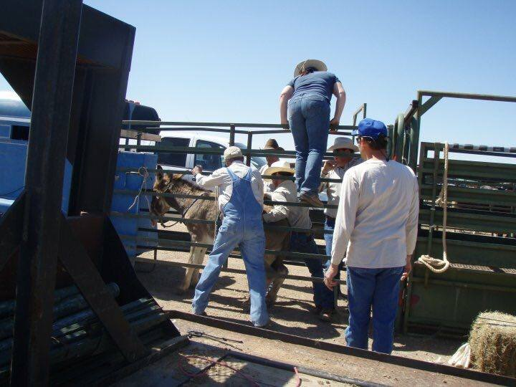
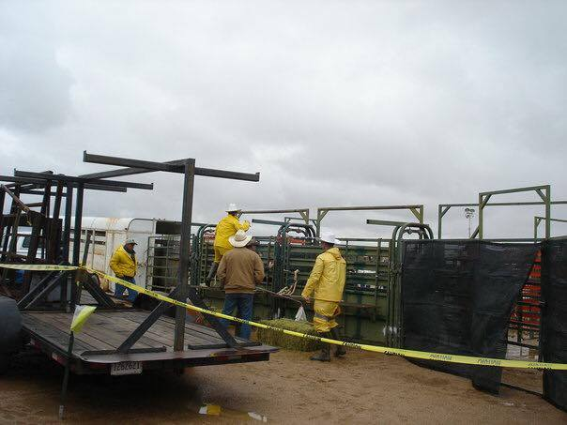
The WHB Program Today
To help ensure that herd sizes are in balance with other public rangeland resources and uses, the BLM removed 4,209 WHB (3,375 horses and 474 burros) from the range in FY17
The BLM placed 3,517 WHB into private care through adoption and sales in FY17
In contrast, 5,701 were placed in 2005
Since 1971, the BLM has homed more than 235,000 WHB

Slide 9
Unit | HMA/HA | HMAP Date | AML | Date AML Established |  | Population | Population Inventory Date |  | % AML
Herd Management Areas
CRD/Kingman | Black Mountain | 1981 & 1996 Black Mtn Ecosystem Plan | 478 burros | 1995 | 1,849 |  | 2012 | 386%
CRD/Kingman | Big Sandy | 1982 | 100 burros | 1995 | 1,588 |  | 2012 | 1588%
CRD/Lake Havasu | Havasu | 1979 | 170 burros | 1979 | 97 |  | 2017 | 57%
CRD/Yuma | Cibola-Trigo | 1980 | 165 burros (112 horses) | 1980 | 861 burros (120 horses) |  | 2014 | 521% burros (107% horses)
PDO/Lower Sonoran | Lake Pleasant | 1999 | TBD | 2001 | 517 |  | 2017 | TBD
CRD/Kingman | Cerbat | 1979 (Draft) | TBD | 2000 | 0 |  | 2014 | TBD
CRD/Lake Havasu | Alamo | 1979 (Interim) | 200 burros¹ | 1983 | 825 |  | 2012 | 412%
 |  |  | 1,113 burros |  | 5,737 burros |  |  | 515% burros
Herd Areas not attached to HMA(s)
AZ Strip | Tassi-Gold Butte | 1982 | 0² | 1998 | 77 |  | 2008
PDO/Lower Sonoran | Harquahala | N/A | 0³ | 2012 | 100 |  | 2002
CRD/Yuma | Little Harquahala | N/A | 0³ | 2012 | 30 |  | 1997
CRD/Yuma | Painted Rock | N/A | 0⁴ | 2011 | 9 |  | 2007
 |  |  | 0 |  | 216
Herd Management Area (HMA) and Herd Area (HA) Information
According to Appendix 1 of Managing Wild Horses and Burros on Public Lands in Arizona dated July 1998, the AML of 200 for the Alamo HMA was set in a Management Framework Plan and is not based on current standards. However, it was based on the studies used for preparation of the Alamo HMAP and is considered to be based on valid standards until monitoring studies indicate a need for change.
The AML for the Gold Butte HMA is zero based upon the 1998 Resource Management Plan amendment that incorporated protection of desert tortoise habitat. All burros from the HA will be removed as funding allows.
The AML of the Harquahala HA is zero based on the 2012 Bradshaw – Harquahala Resource Management Plan. All burros from the HA will be removed as funding allows.
The AML of the Painted Rock HA is zero based on the 2012 Lower Sonoran Resource Management Plan. All horses and burros from the HA will be removed as funding allows.

Slide 10
WHB in Arizona
WHB Removals in Arizona
Adoption/Sales in Arizona
Year | Horses | Burros | Total
2013 | 0 | 61 | 61
2014 | 0 | 140 | 140
2015 | 0 | 361 | 361
2016 | *26 | 119 | 145
2017 | 0 | 401 | 401
2018 | 0 | 806 | 806
Fiscal Year | Horses | Burros | Total
2013 | 68 | 45 | 113
2014 | 54 | 20 | 74
2015 | 116 | 50 | 166
2016 | 170 | 50 | 220
2017 | 192 | 48 | 240
2018 | 255 | 206 | 461

Slide 11
Bait Trapping
Nuisance wild burros are bait trapped using a temporary corral
At request of a private land owner
Hay, water, molasses, and dates are used for bait
Once caught, animals are transported to prep facility where they will be made available for adoption

Slide 12
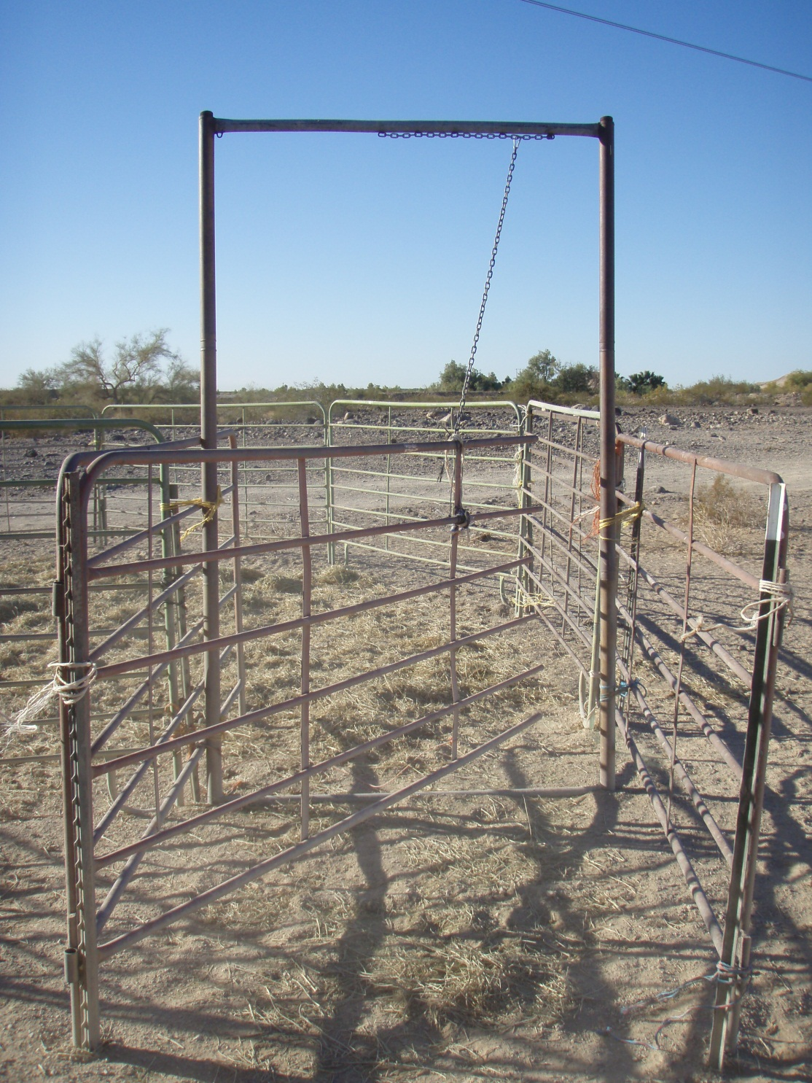
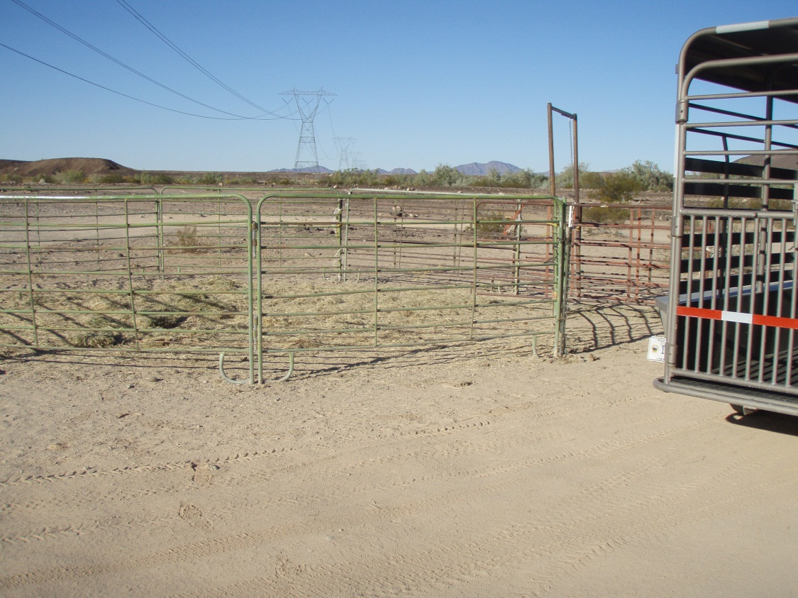
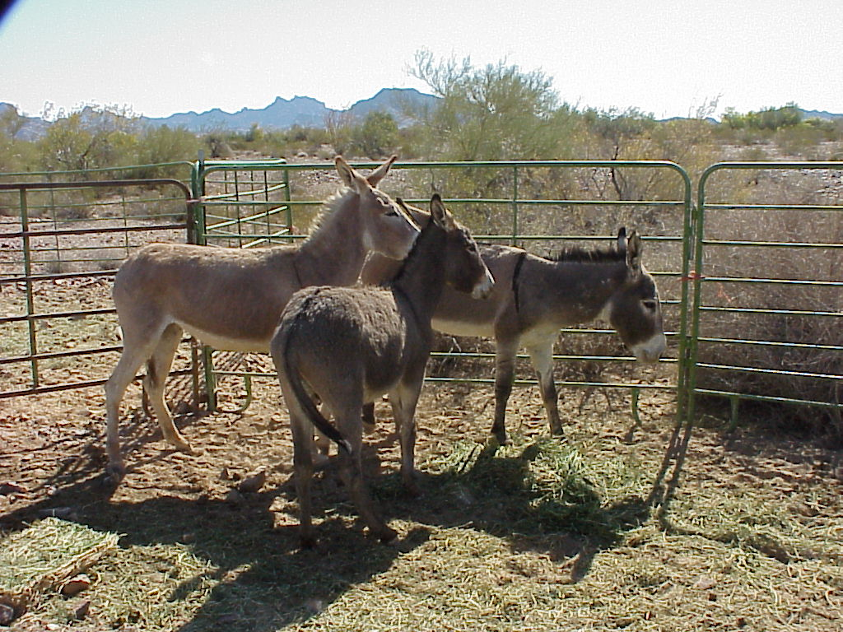

Slide 13
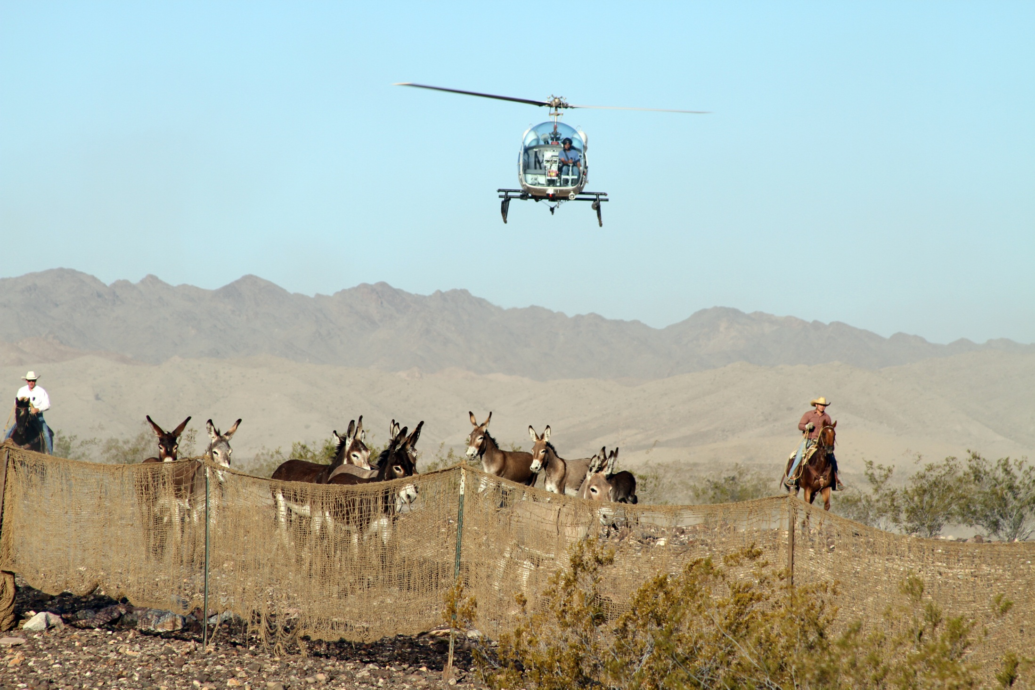

Slide 14
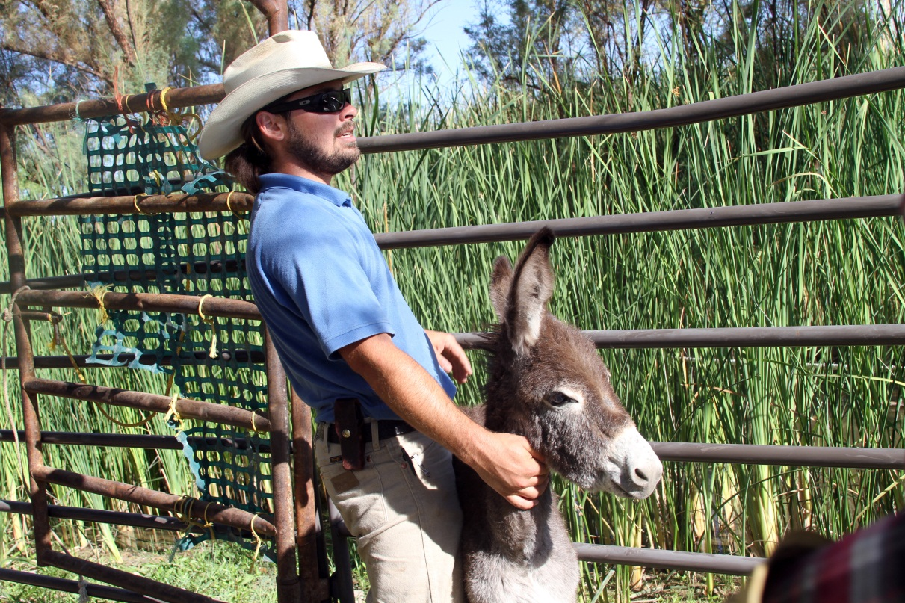
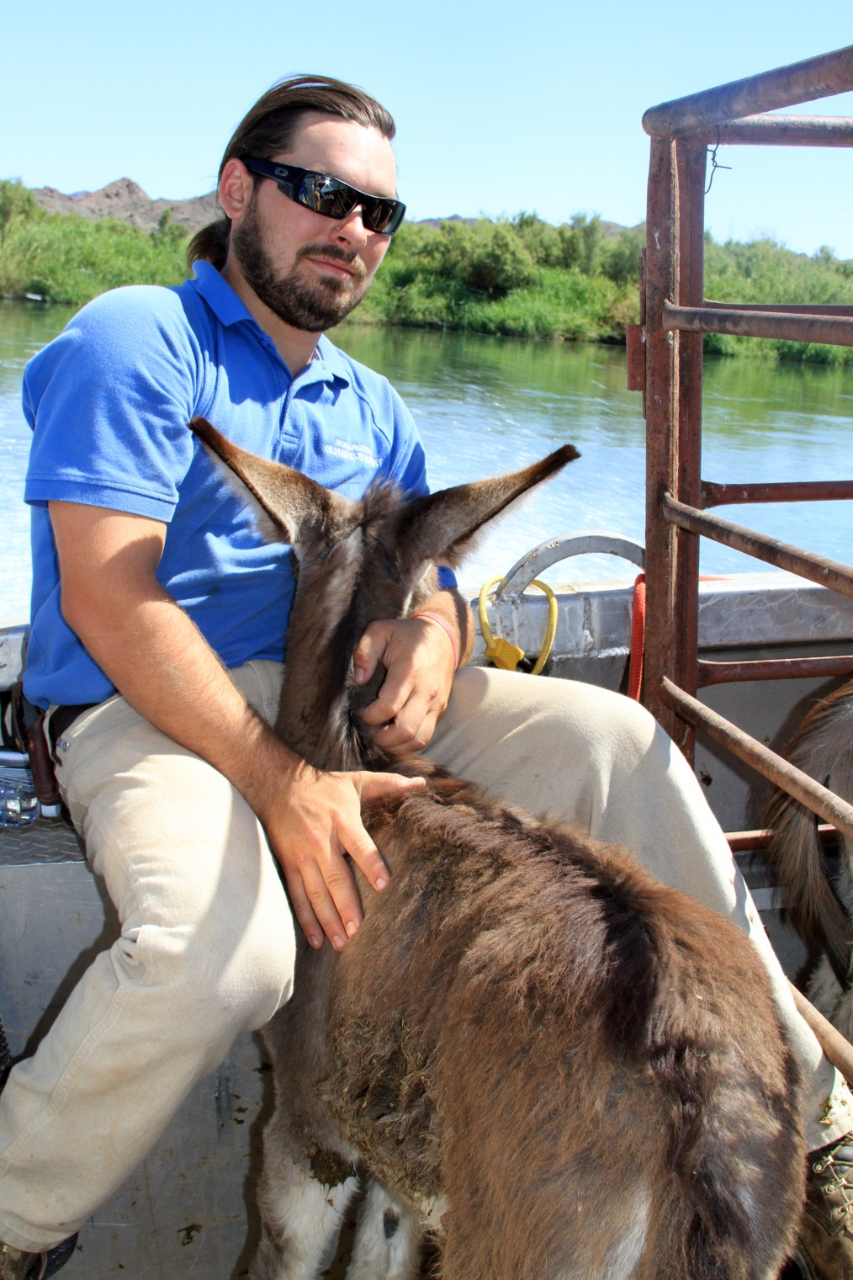
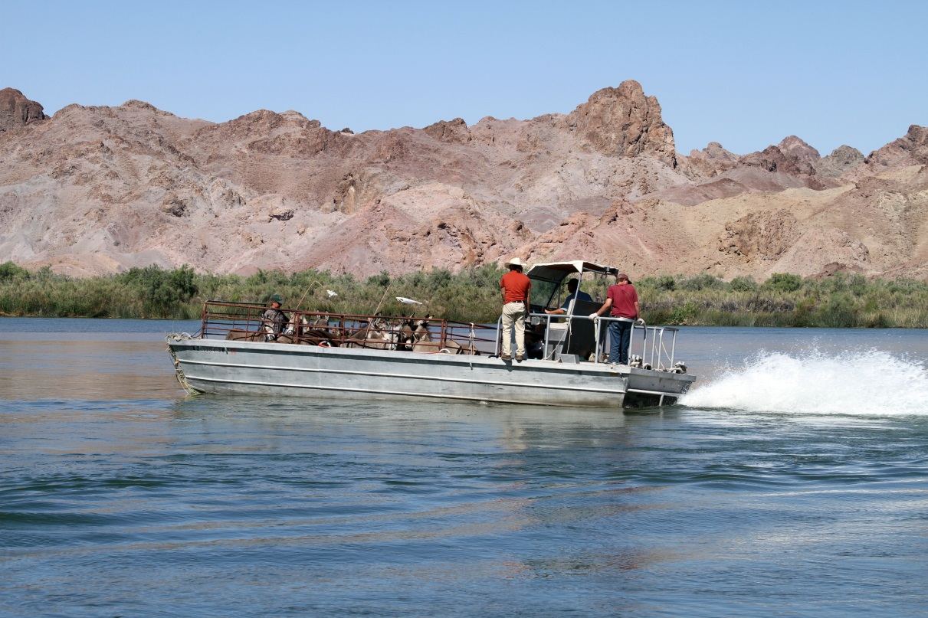

Slide 15
Florence WHB Training and Holding Facility
Opened in 2013
Capacity of 1,000 WHB
400 is average daily inventory
Integrates care, maintenance, and training all at one facility

Slide 16
Current Burro Research in Arizona
Black Mountain HMA Porcine Zona Pellucida (PZP)
Designed to test effectiveness of field application of PZP to Wild Burros
75 Wild Burros have been treated in three test groups
Project is in year 2 of 4

Slide 17
Burro Research in Arizona
Lake Pleasant HMA Collaring Project
Project designed to track Wild Burro demography, movement, and tests new aerial survey methods designed to provide increased accuracy of population estimates
56 Wild Burro have been collared as of July 2018

Slide 18
Issues with the Burros in AZ
Overutilization of key forage species needed by wildlife
Animal/Auto collisions
On average, about 20 collisions occur every year
Burros cross the road to access vegetation or water
Burros can range 4-6 miles in one day and any waters within 4 miles roadways cause a significant safety issue for the public

