Slide 2
Equine Trail Sports PARTNERS IN TRAIL ADVOCACY
Holly Carson, Co-Founder Equine Trail Sports
Over 1500 Competitive Trail Events Conducted
Over 7000 Riders
Only Organization Empowers the Riders:
To Compete the Way they Learn
To CHOOSE the Challenge Appropriate for their Equine Partner
Mary Sutherland, 1st Ever ETS Host Nationwide
Equine Trail Sports Host, Trainer, Clinician with 10 years experience putting on competitive trail riding events. Managed the 1st ever competitive trail event with ETS, which has grown into a nationwide competitive trail riding organization. Founding advisor ETS.
Arizona Equine Trail Advocate with over 40 years experience riding, helping maintain trails, and search and rescue in the Southwest and AZ. Active with Arizona Back Country Riders, Pony Express Saddle Club, Maricopa County Mounted Sheriff's Posse, and one of the founders of the Greater Queen Creek Horse Owners Assoc., which preserves an active and unique 11 mile multi-use trail system in the greater Queen Creek area..
Owner of Sutherland Training for 35 years, training under major clinicians including training with, and working for, Pat and Linda Parelli for 12 years

Slide 3
TRAILS
USE THEM OR LOSE THEM

Slide 4
EQUINE TRAIL SPORTS USING TRAILS
TRAIL CHALLENGE (TC) A course including 5-10 miles of trail.
OBSTACLE TRAIL (OT) A course including any combination of arena, field, and 2-4 miles of trail.
OBSTACLE COURSE (OC) A course including any combination of arena, field, and up to 1 mile of trail.
OBSTACLE COURSE (OC) IN HAND A course including any combination of arena, field, and up to 1 mile of trail, with handler on the ground.
RECREATION RIDE (RR) 5 to 10 miles of recreational riding.

Slide 5
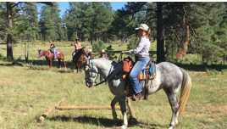
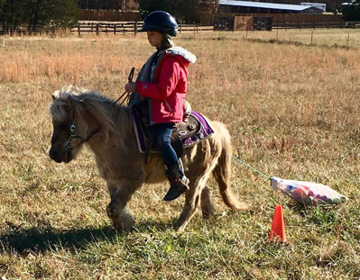
ENGAGE MORE RIDERS GET THEM ON TRAIL & THEY’LL COME BACK!
YOUTH & FAMILIES – affordable family time
LEISURE RIDERS – reason to ride
CASUAL COMPETITOR – improving partnership
PERFORMANCE RIDER – let them be a horse
BREED ASSOCIATIONS – added recognition

Slide 6
MAKE TRAIL RIDING COMPELLING
SENSE OF SAFETY: A safe and supported opportunity to ride new locations
SOCIAL: Ride with friends and friends you’ve yet to meet
WELCOMING AND AFFORDABLE: A family friendly event that everyone can enjoy, ages 7+!
NO PRESSURE: Riders customize their event experience! No competitive experience necessary. Relaxed and FUN!

Slide 7
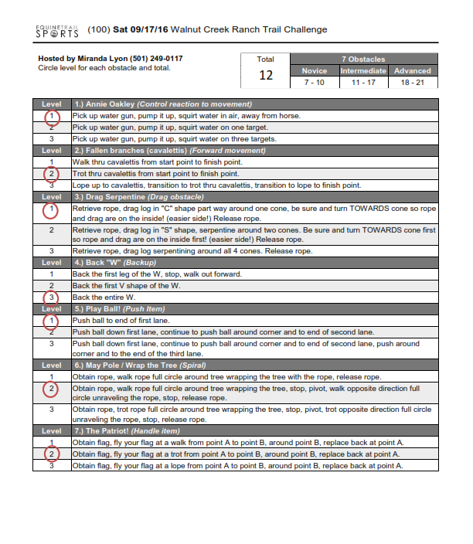
SAMPLE
OBSTACLE SHEET
RIDERS CHOOSE DIFFFICULTY LEVEL AT EACH OBSTACLE

Slide 8
LIFETIME AWARDS – RIDE FOR A REASON

Slide 9
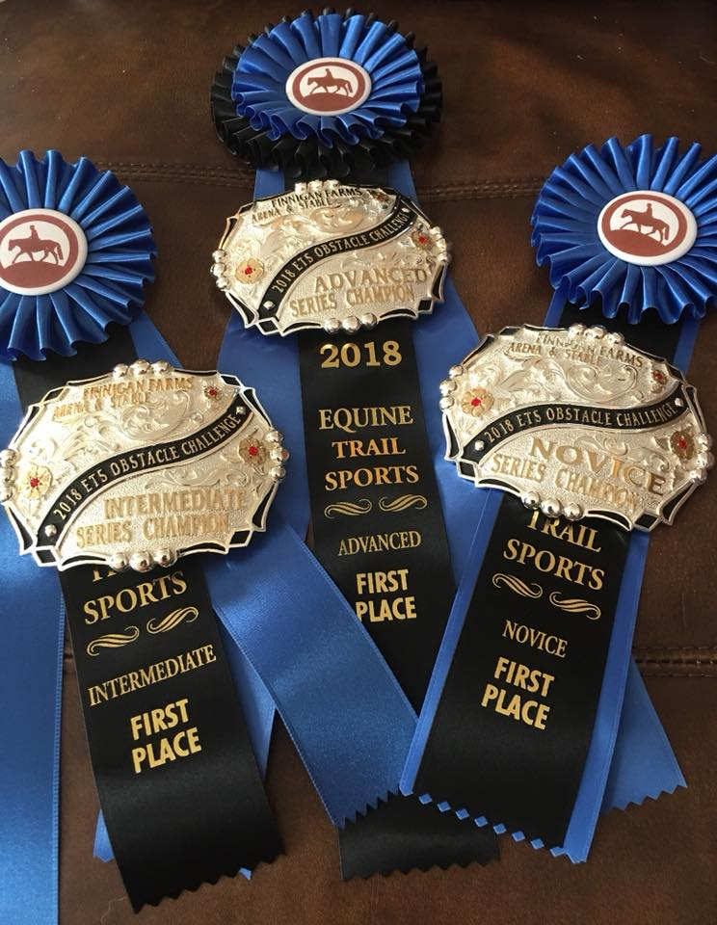
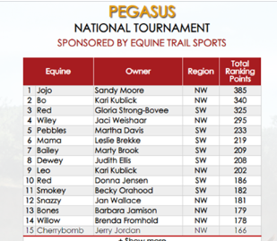
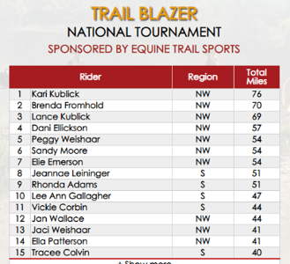
MORE REASONS TO RIDE

Slide 10
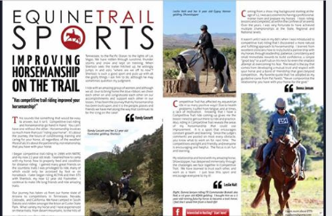
RIDE TO LEARN
SAFE RIDER
HAPPY RIDER
REPEAT RIDER

Slide 11
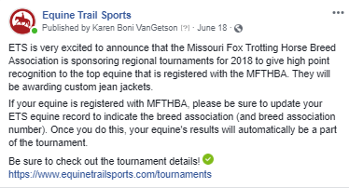
OUTREACH – BREED ASSOCIAITONS

Slide 12
EXPOS 2019
INTRODUCING RIDERS (EXPO ATTENDEES) COMPETITIVE TRAIL THROUGH LIVE EXPERIENCES
HOST COMPETITIVE TRAIL CHALLENGES AT EXPOS
OBSTACLE CLINICS
OBSTACLE DEMONSTRATIONS
BREAKOUT SESSIONS
COMPETITIVE TRAIL SCORING – JUDGING
PERFECTING THE PARTNERSHIP - INTREPRETING SCORES

Slide 13
EQUINE TRAIL SPORTS CAN HELP WITH GOALS
Increase awareness of your organization or ride location!
Raise funds for your trail maintenance!
Provide a Fun and Safe activity for the community and ridership!

Slide 14
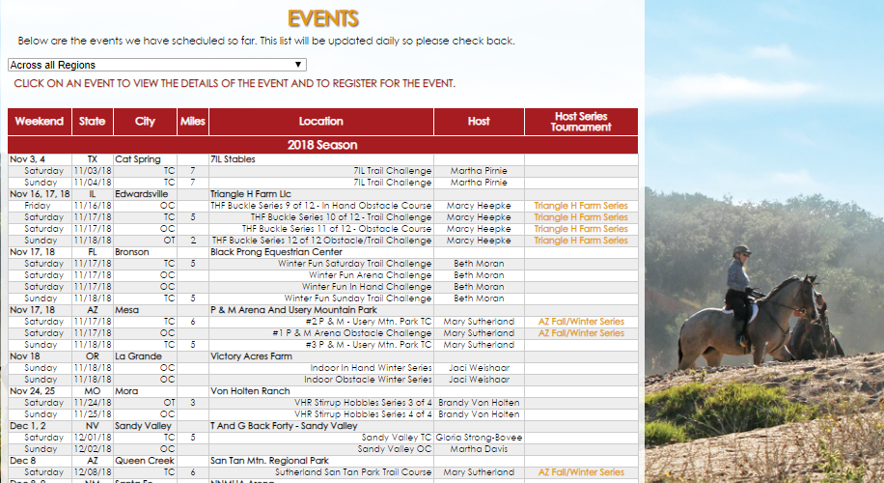

Slide 15
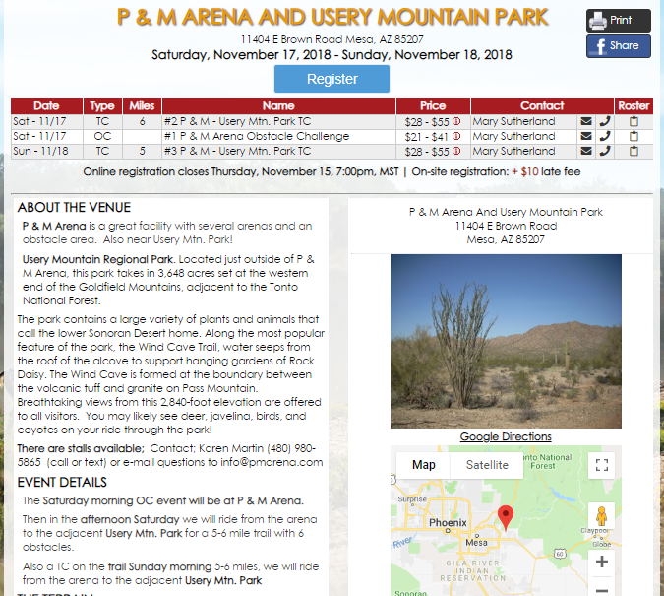

Slide 16
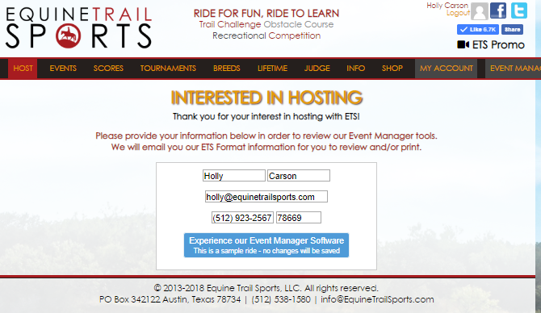

Slide 17
OUR MANAGEMENT TOOLS

Slide 18
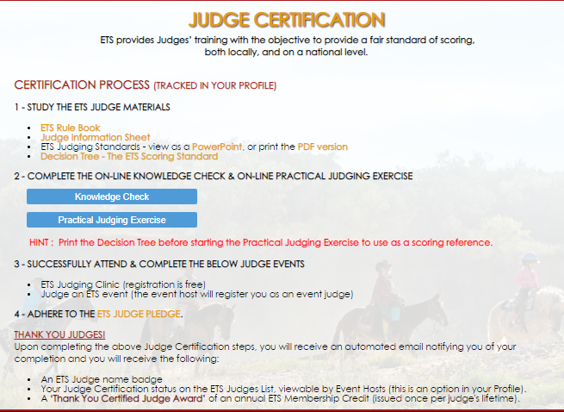

Slide 19
SCORING
20 points total per obstacle: 0 – 10 equine and 0 – 10 rider. Whole numbers only.
Judges use the below Scoring Scale to score horse and rider according to the OBSTACLE CRITERIA.
Pluses
Awarded at the judge’s discretion for any performance
Are NOT added to the overall score.
Used to break ties.
One plus can be given for any score range for the horse and/or rider.

Slide 21
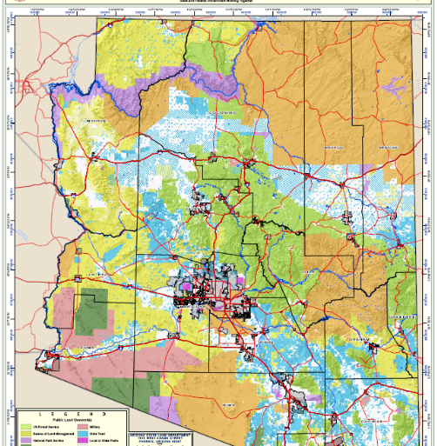
HELP US HELP YOU Arizona Example
Focus: Overcome challenges facing competitive groups:
Help from State
Help from BLM
Help from National Parks

Slide 22
